Slide 1
ANNAMALAI UNIVERSITY DEPT. OF COMMERCE
RECENT TRENDS IN SERVICES MARKETING
WELCOME PARTICIPANTS

Slide 2


AN INSIGHT INTO THE POTENTIALS OF SERVICES MARKETING IN INDIA by
Dr.D.Ilangovan, M.Com.,Ph.D. Prof. & Head,
Dept. of Commerce, Annamalai University

Slide 3


Slide 4

MARKETING DEFINED

Slide 5


Slide 6


It is a Matter of Cooperation

Slide 7
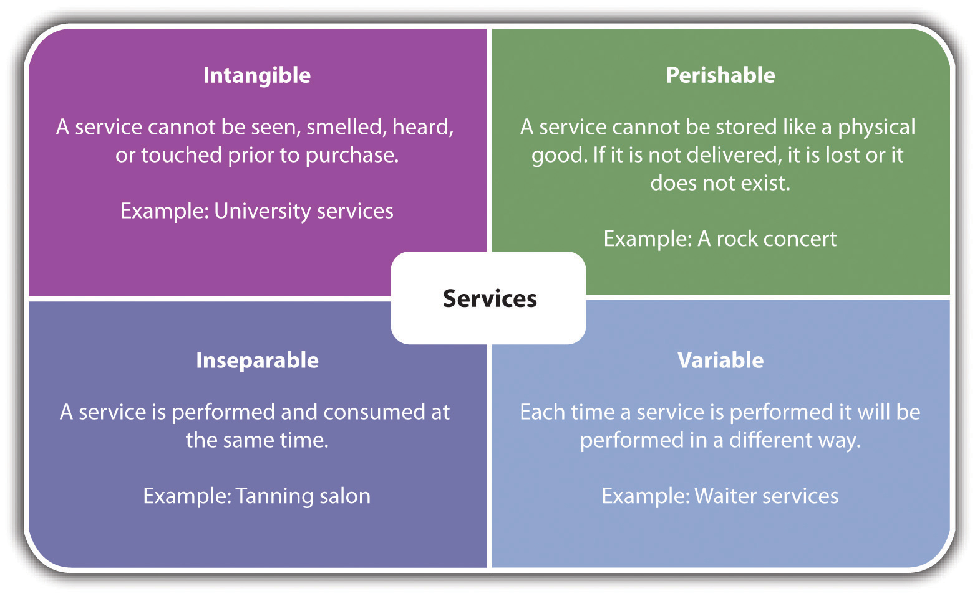

Slide 8
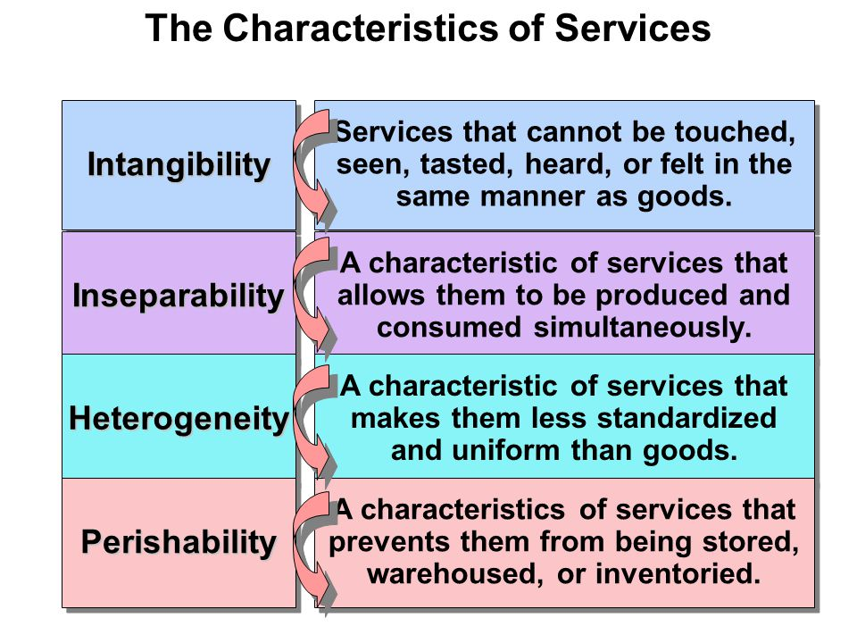

Slide 9
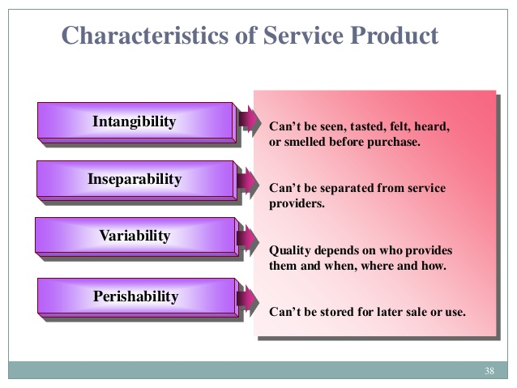

Slide 10
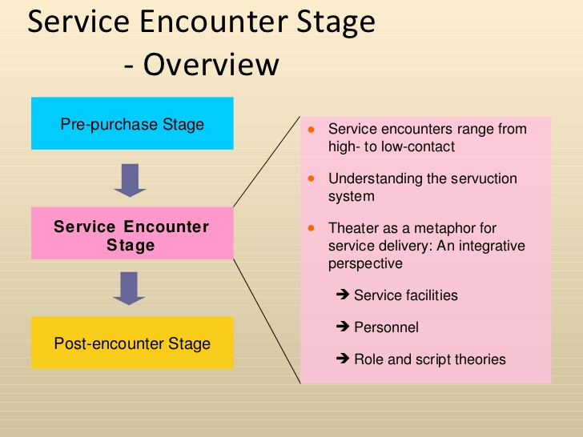

Slide 11
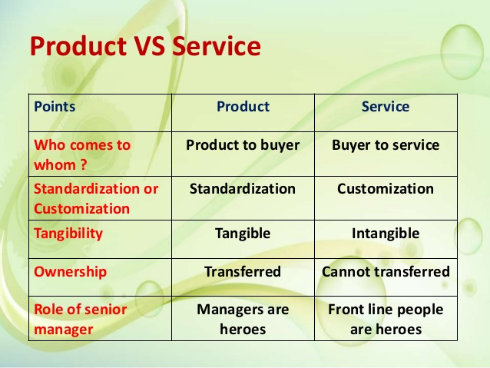

Slide 12


Slide 13
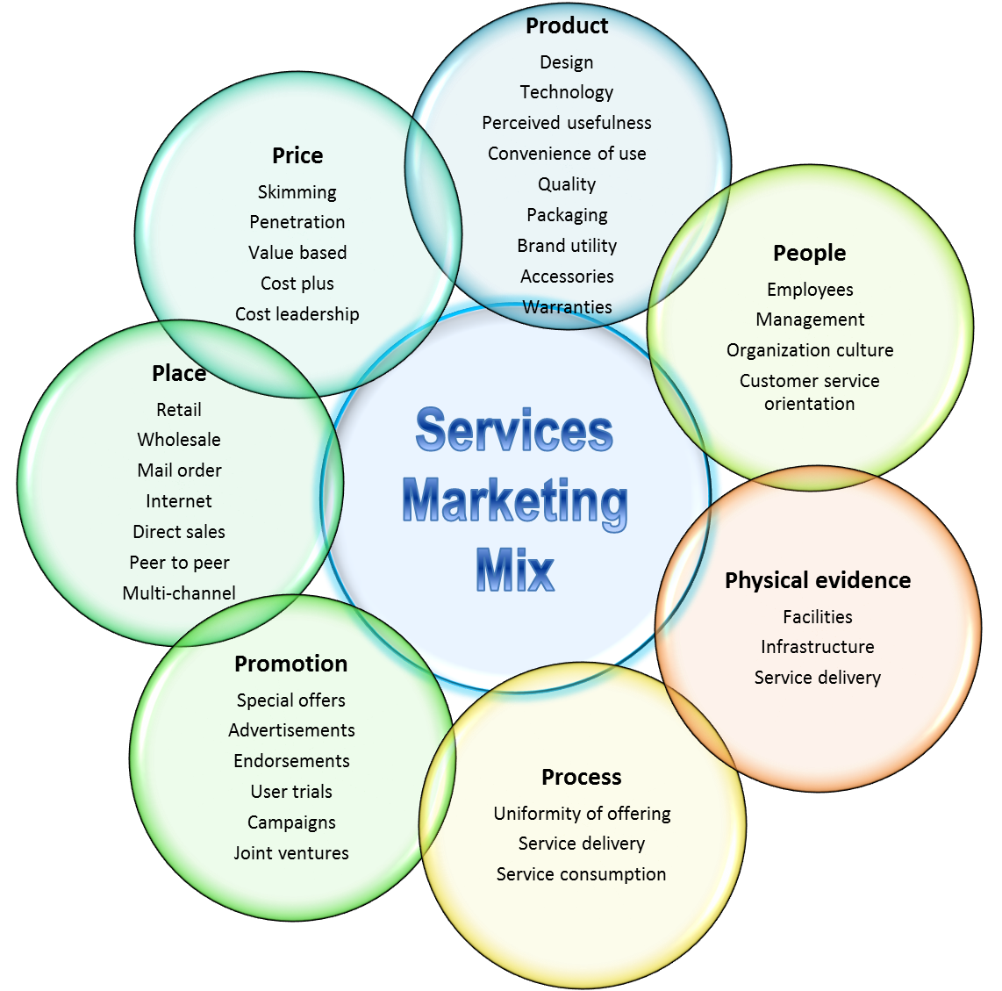

Slide 14
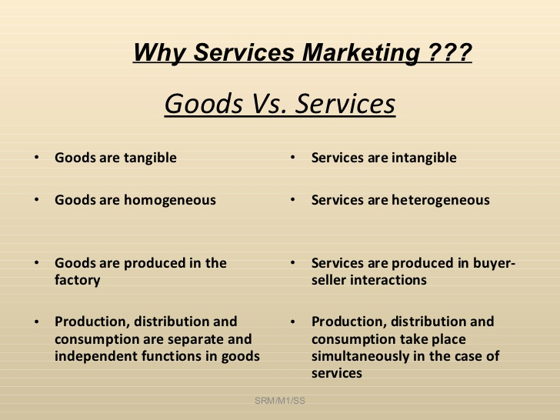

Slide 15
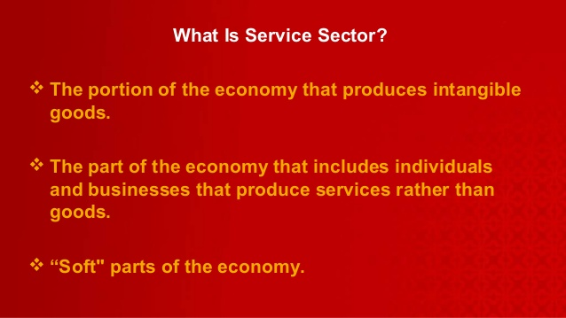

Slide 16
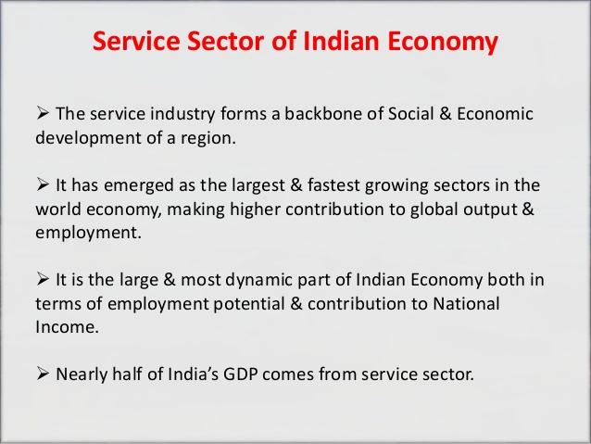

Slide 17
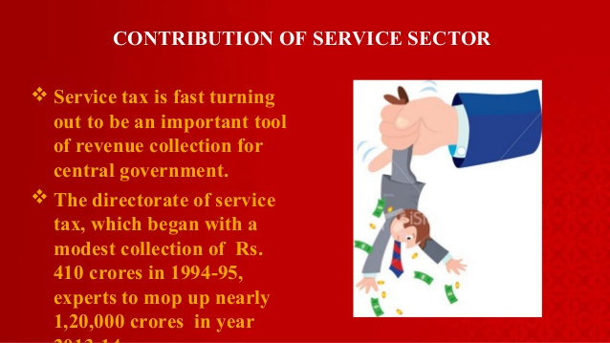

Slide 18


THE BUZZ WORD IS ‘SERVICE’

Slide 19


Slide 20
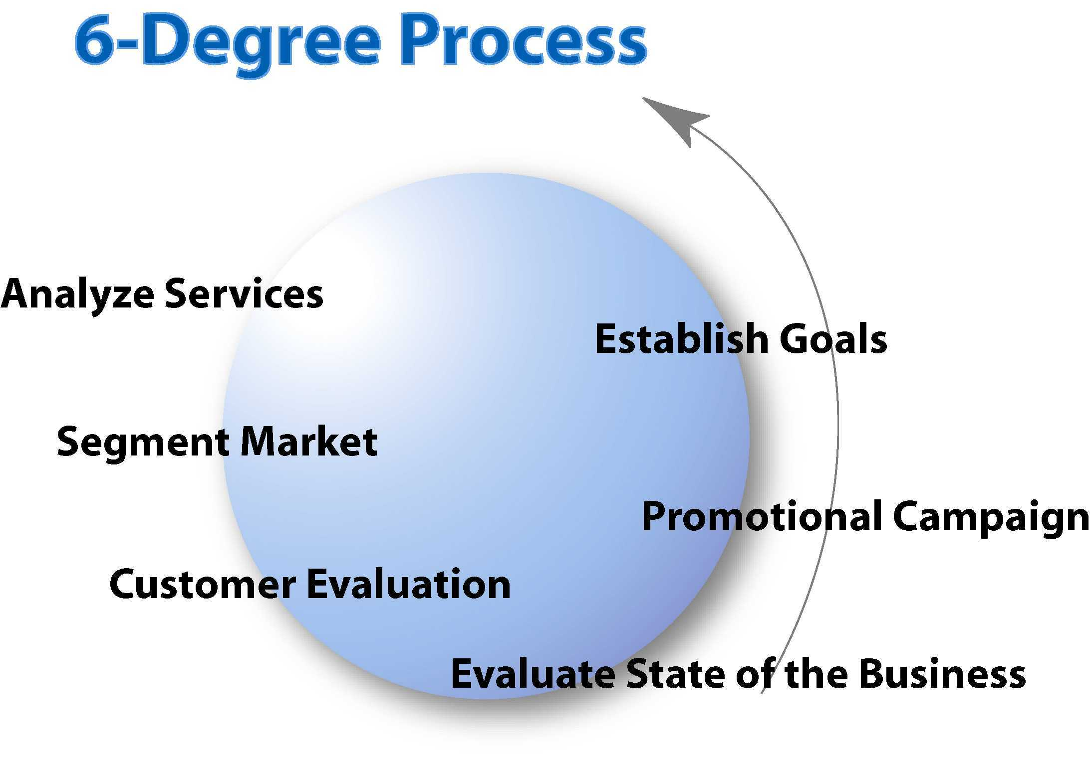

Slide 21
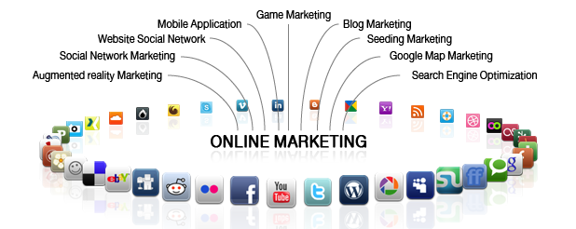

Slide 22


Slide 23
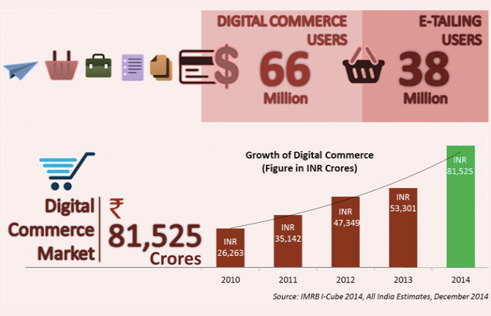
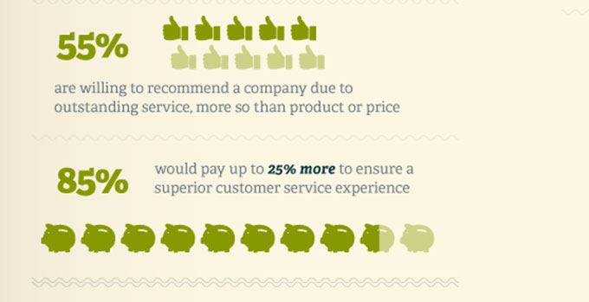
‘SERVICES’ GAIN MOMENTUM

Slide 24


TOP MOST NATIONAL INTEREST

Slide 25
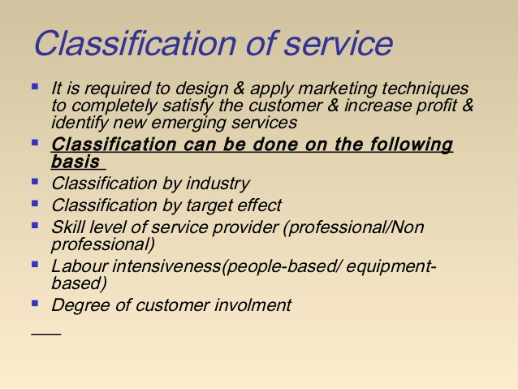

Slide 26
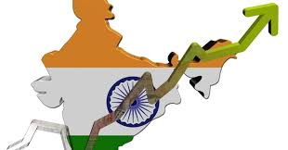
WE ARE TOO GOOD IN ‘SERVICES’

Slide 27
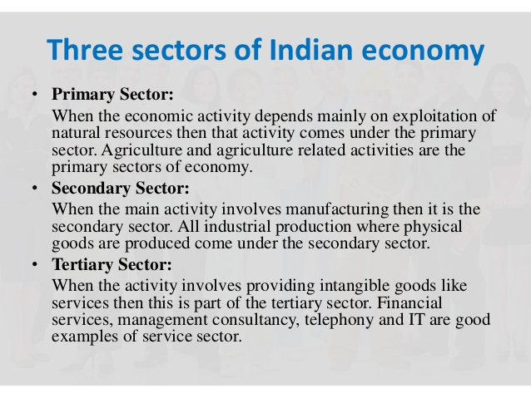

Slide 28


Slide 29
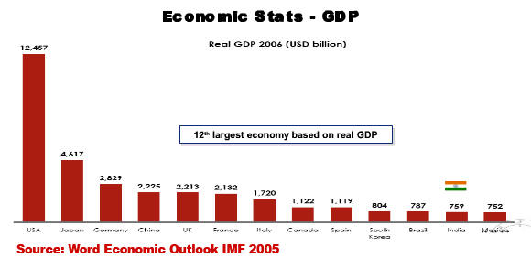

Slide 30
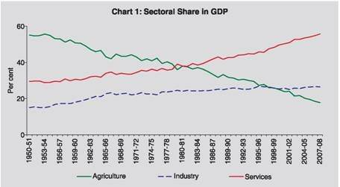

Slide 31
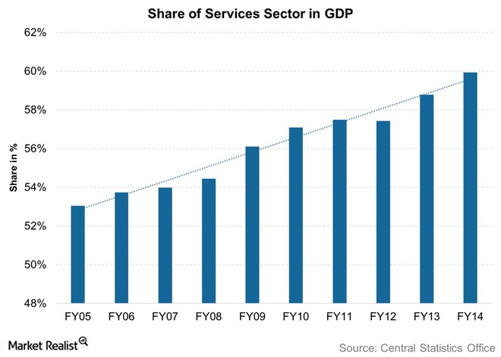

Slide 32
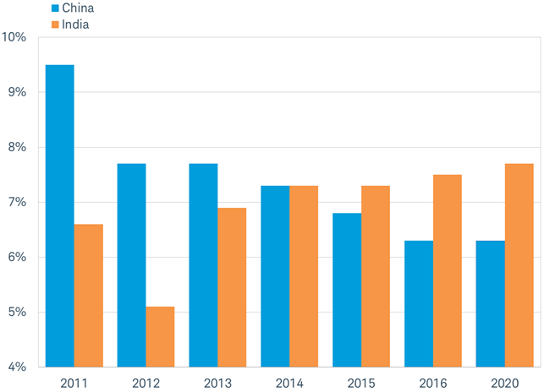
GROWTH RATE OF CHINA & INDIA

Slide 33
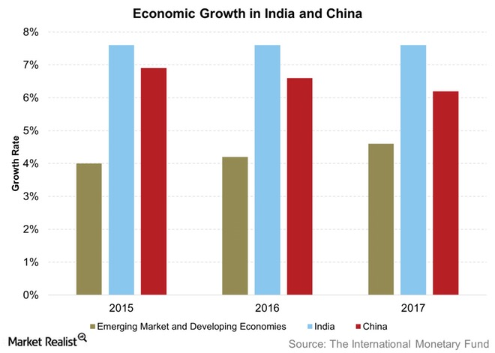

Slide 34
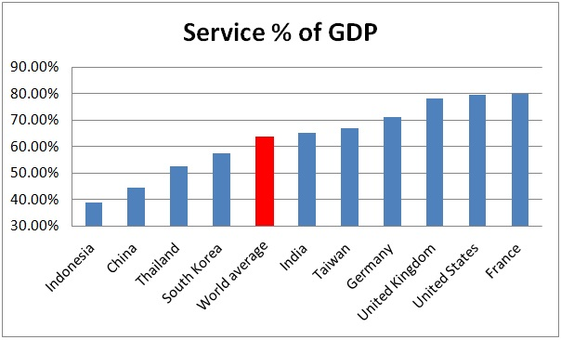

Slide 35

UNFOLD THE UNLIMITED POTENTIALS IN SERVICES SECTOR

Slide 36
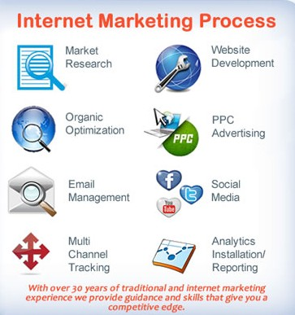

Slide 37

OUR AIM MUST BE ALWAYS HIGH

Slide 38
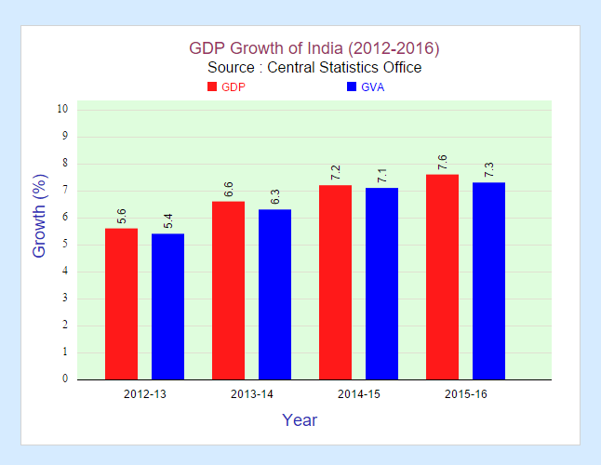
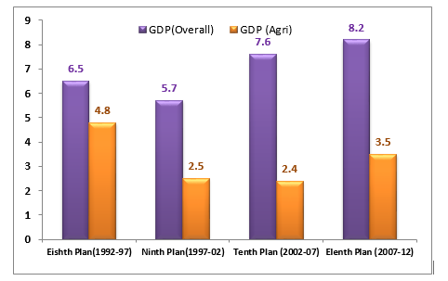
GROWTH RATE - AN INSIGHT

Slide 39
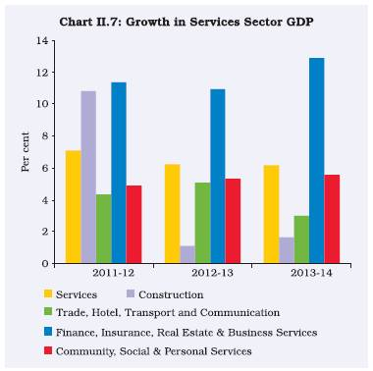

Slide 40
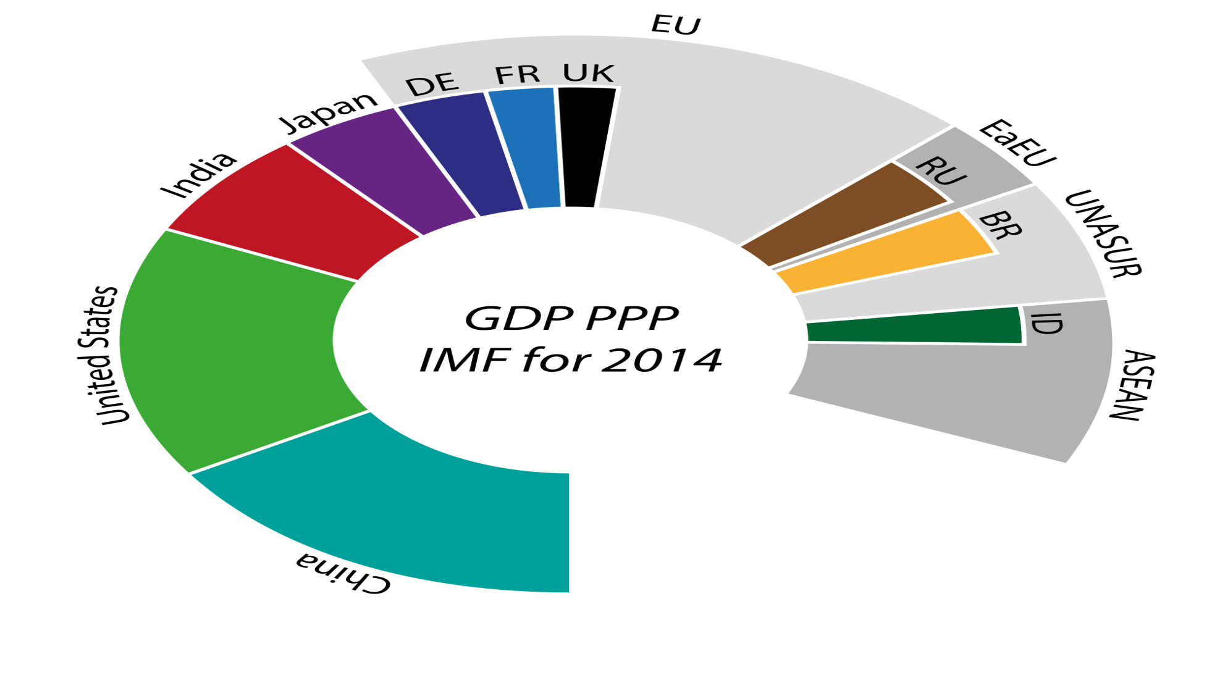
FROM 12TH TO 3RD PLACE…..

Slide 41

SKY ROCKETING GROWTH POSSIBLE THROUGH ‘SERVICES’

Slide 42
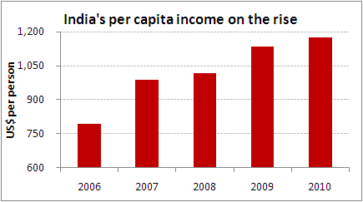

Slide 43
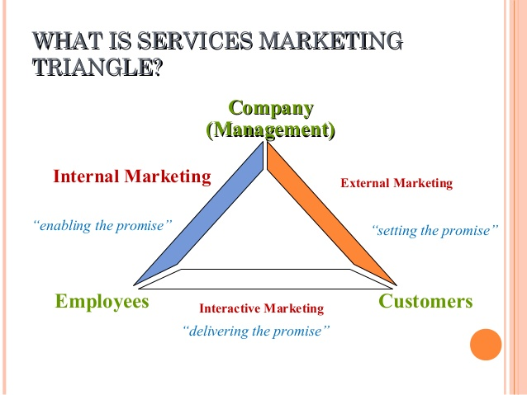

Slide 44
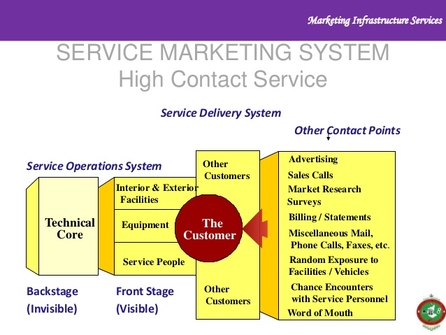

Slide 45
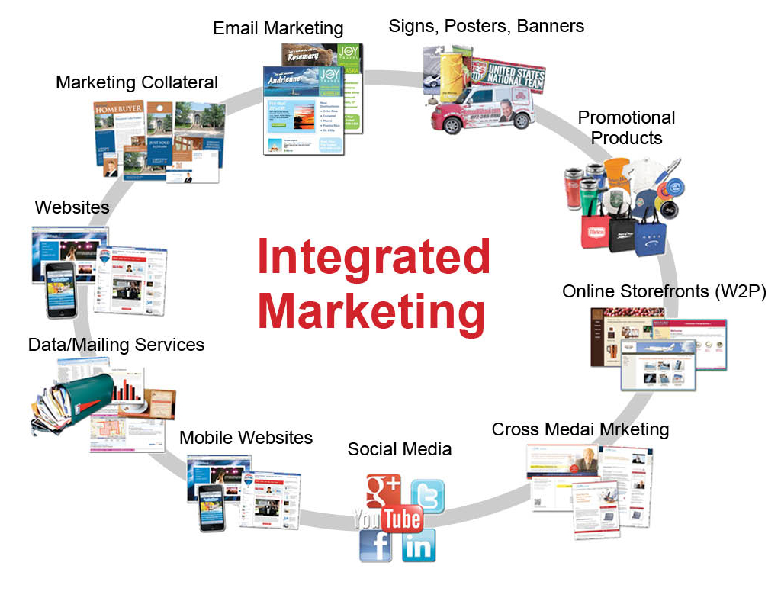

Slide 46


Slide 47
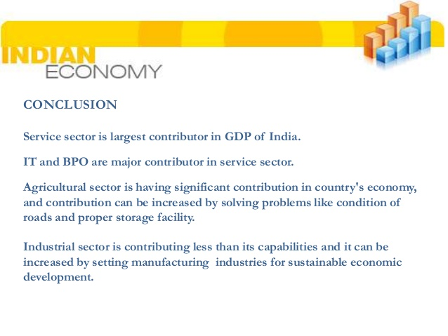

Slide 48

THANK YOU ALL
SKY IS THE LIMIT

Slide 49

JAI HIND !

